Slide 1
Fitness friday Lesson
From the IA4L’s Building a Virtual Classroom Community At-Home Resource

Slide 2
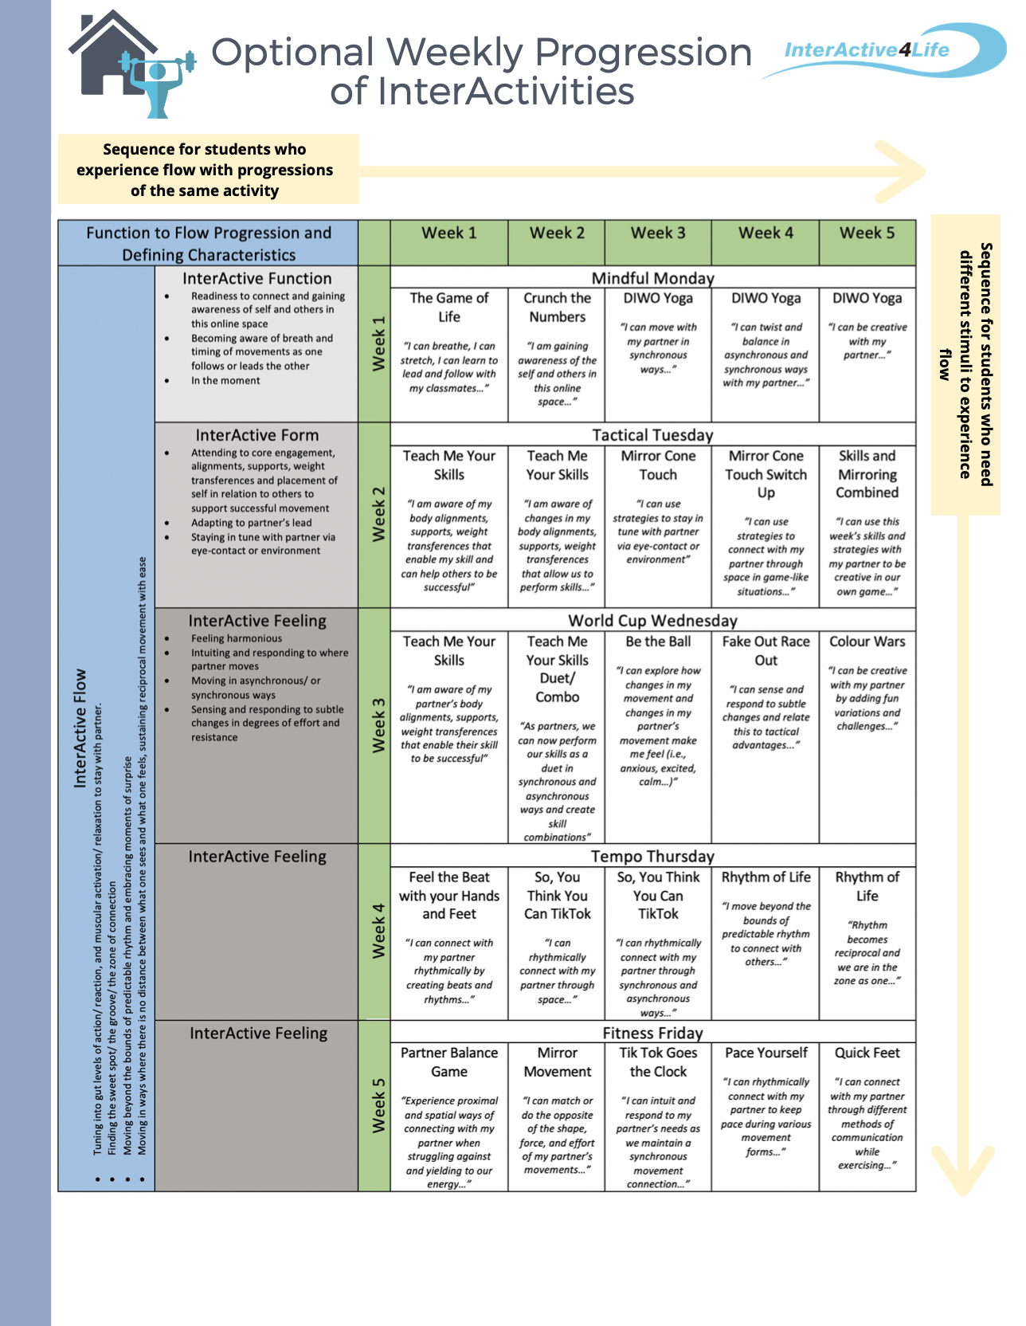
Notes:
There are two ways to progress through this at-home learning module. You can travel down on the table or across. Traveling down (e.g., choosing Week 1 → The Game of Life → Teach Me your Skills → etc... ) would allow more variation in activities each day. One of the major goals of this module is that students experience relational flow with their partners. Some students need more spontaneity and variety to experience this. Traveling across (e.g., Week 3 → Teach Me Your Skills → Teach Me Your Skills Duet → Be The Ball → etc…) allows for progression through the same activity or variations of the same activity which is beneficial for students who like to practise to make things perfect - or in this case, practice to eventually get into a flow state.

Slide 3
Lesson Overview
Welcome to a Fitness Friday Lesson. In today’s lesson we will practise Quick Feet InterActivity together.
Student Targets
01
Connect with partner through spatial and distal means, attend to InterActive feelings as they intuit and respond to where partner moves.
Function 2 Flow
02
Develop health and skill related fitness components to increase physical literacy.
Curriculum
03
Practice interpersonal skills such as communication, relationship, and social skills while attending to partner.
Social Emotional Learning

Slide 4
Quick Feet
Activity Overview: Students will work in synchronous and asynchronous ways and explore different methods of communication while exercising.
Warm Up: Students take turns commanding their partner to do an exercise with them in coded messages verbally. The follower must react to their commands.
Main Activity: Students perform the same activity with the constraint that it must be done in silence. For an added challenge, students play opposites where the pair must perform the opposite exercise to which the leader commands (i.e., “hit the deck” = “reach for the sky”).
Cool Down: In pairs, students take turns leading each other through various static stretches while maintaining synchronous connection.
WATCH THIS ON (CLICK HERE)
We support teachers at home. For more information on this InterActivity see pgs. 72-74 of the IA4L Building a Virtual Community At-Home Resource.
Notes:
Image Retrieved from:https://www.clipartkey.com/search/cartwheel/
Image Retrieved from:https://www.clipartkey.com/view/howhwo_transparent-megaphone-clipart-png-megaphone-icon-png-transparent/

Slide 5
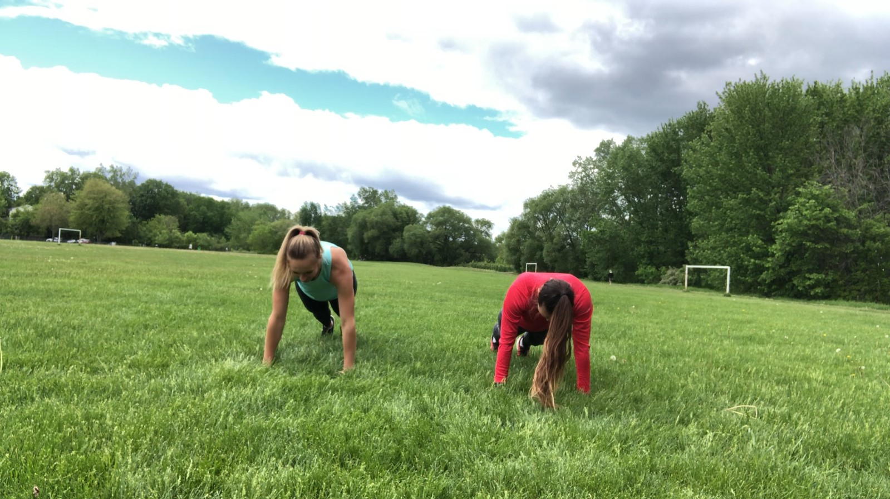
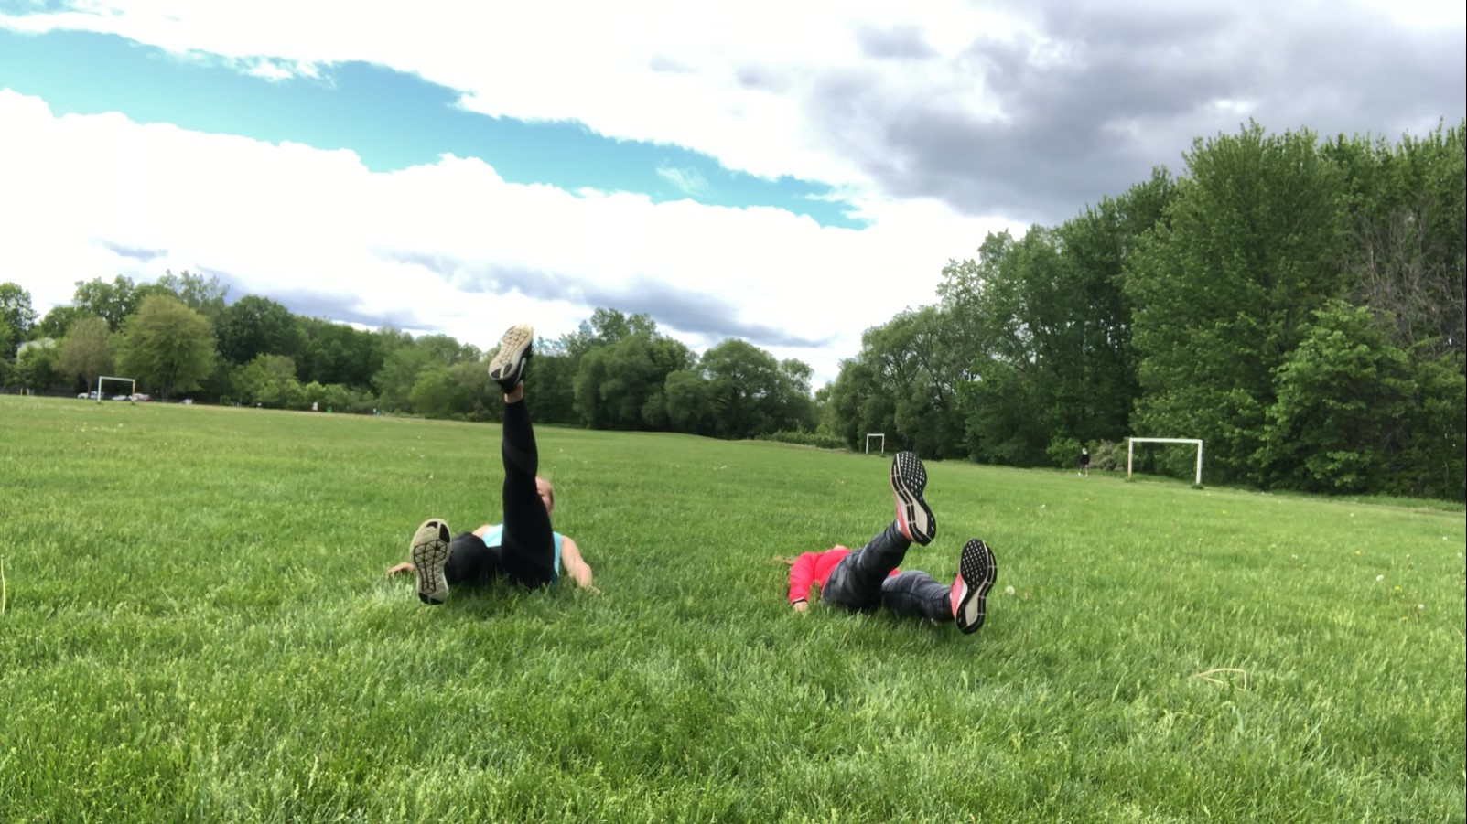
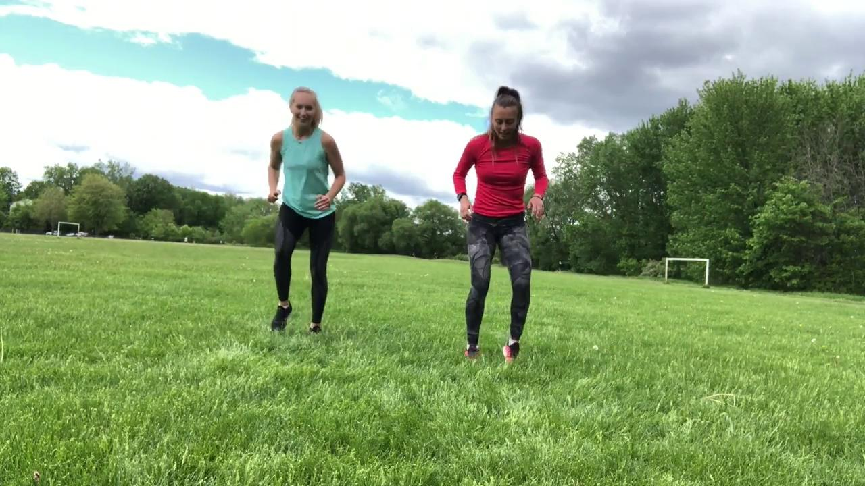
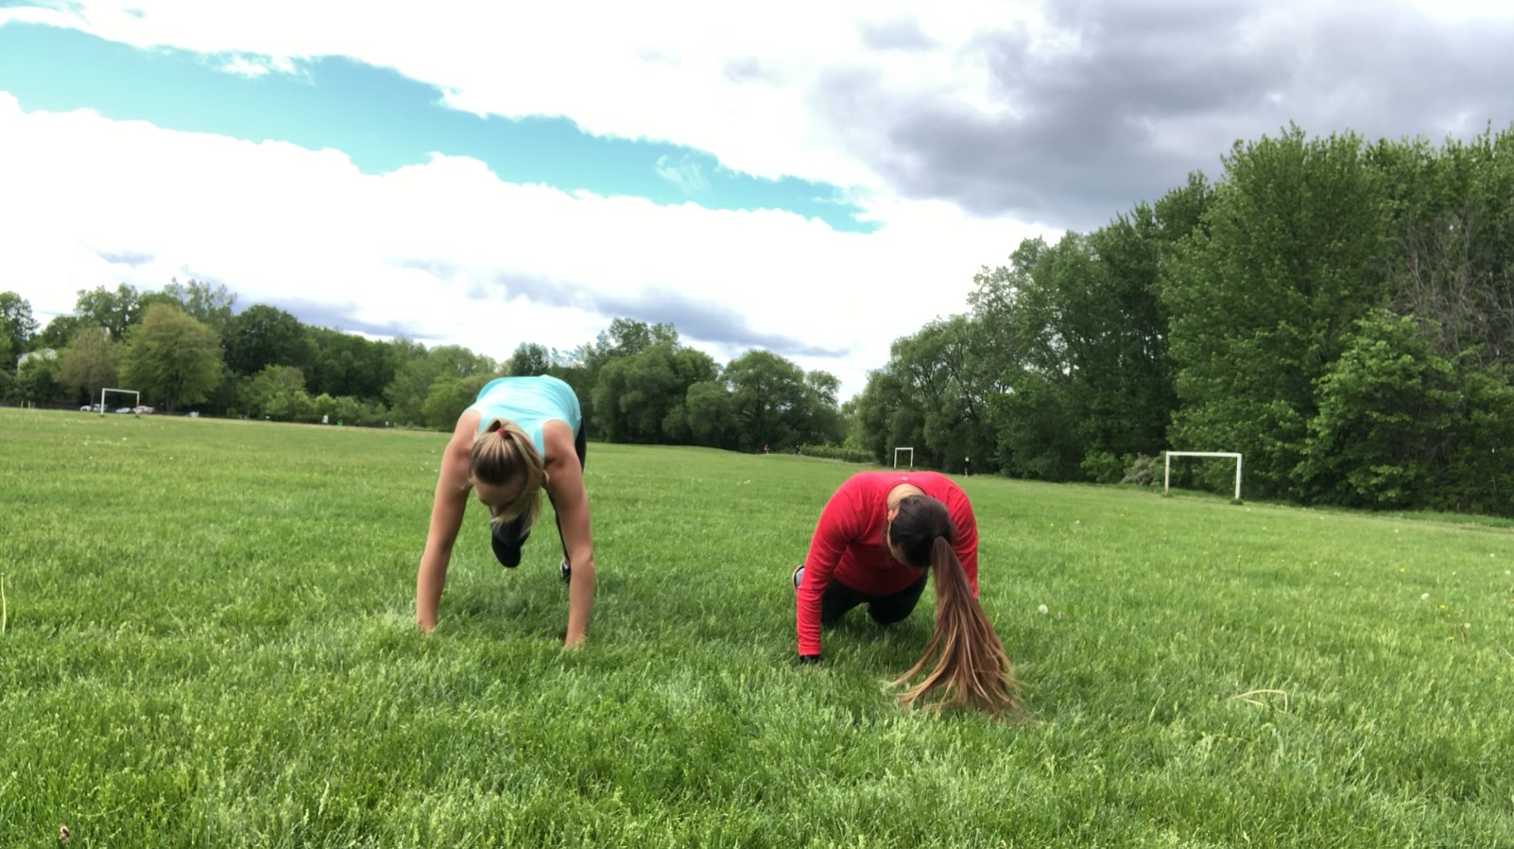
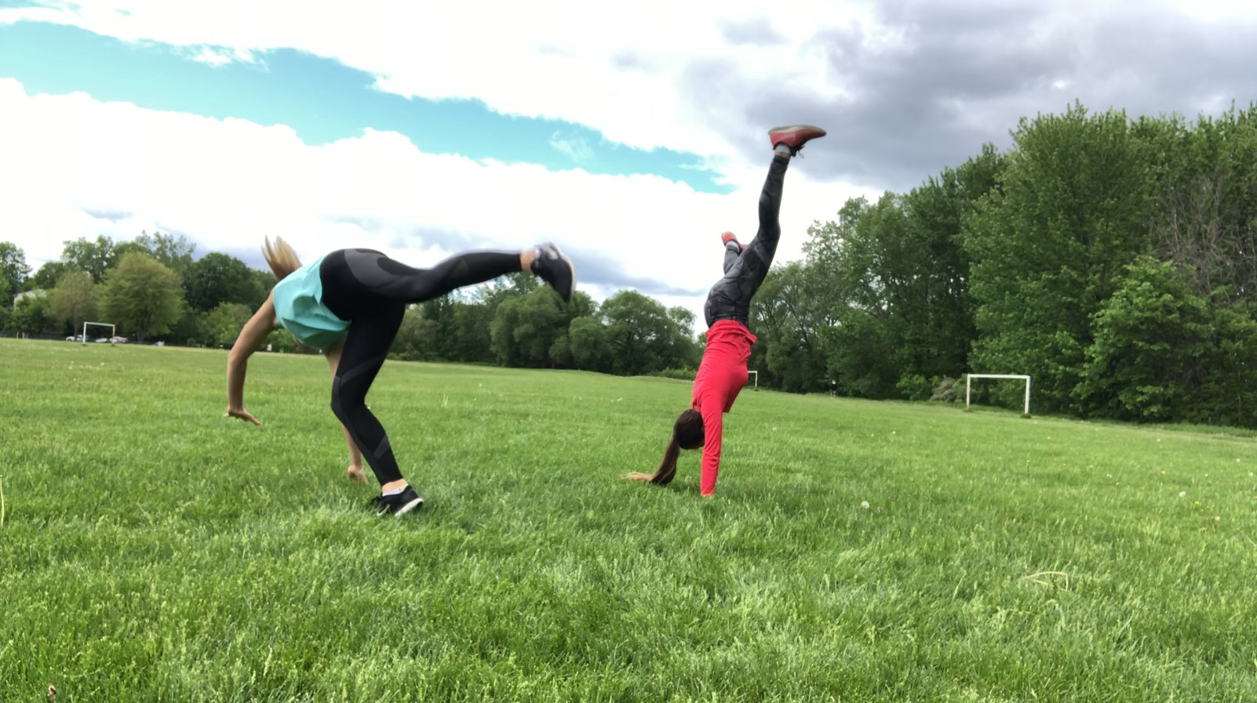
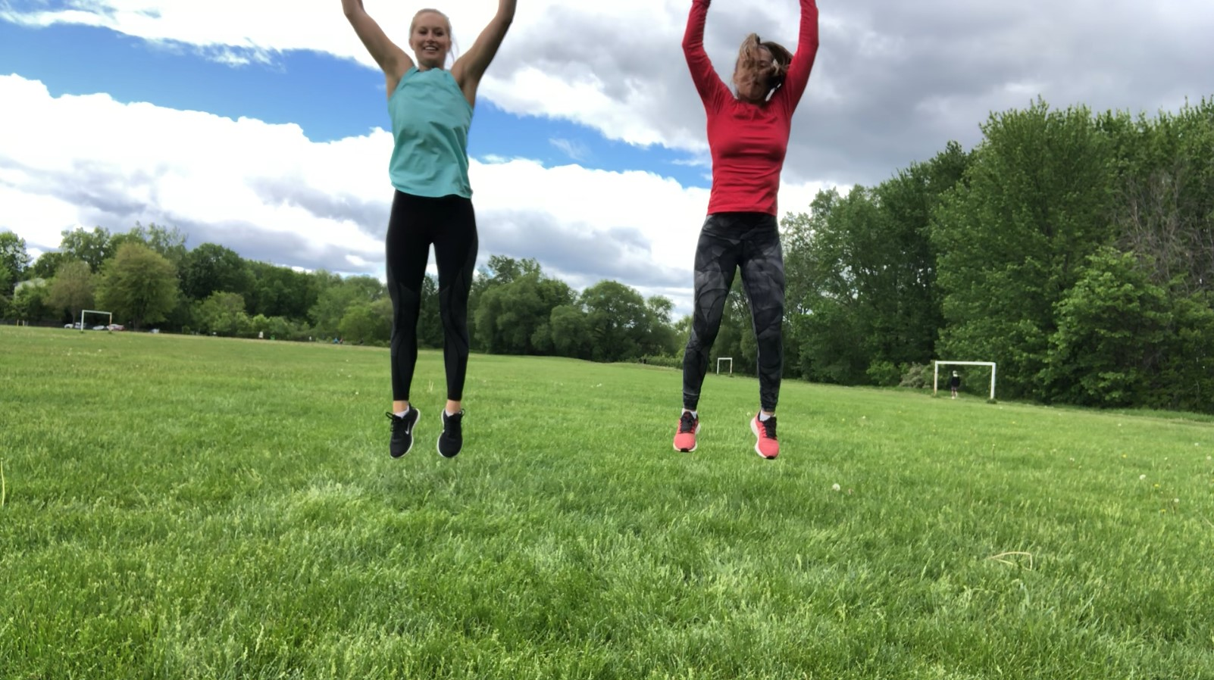
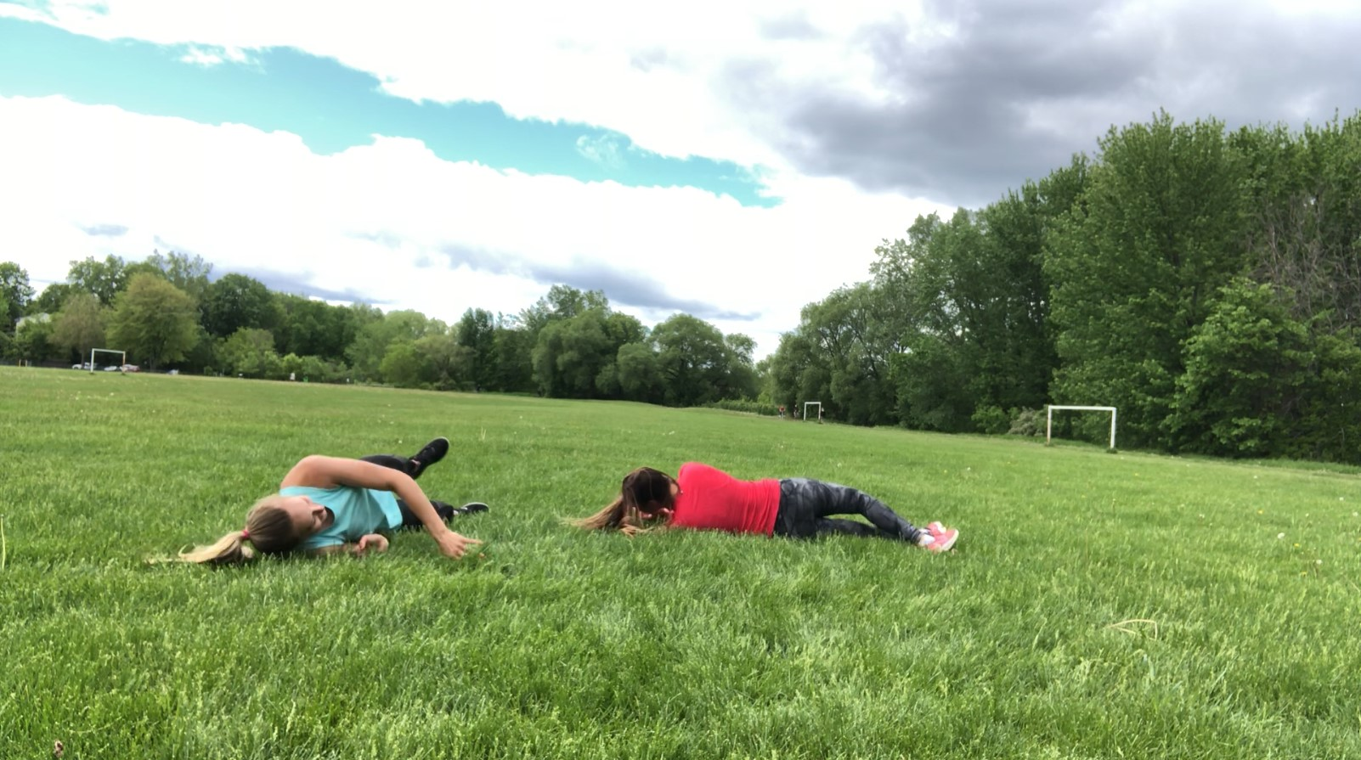
Quick Feet
Main Activity: Quick Feet
Walk the Plank: Plank
Stormy Sea: Flutter kicks
Hit the Deck: Burpee
Person Overboard: Cartwheel
Video demo: click here!
Reach for the Sky: Jump
Put Out the Fire: Get down and roll

Slide 6
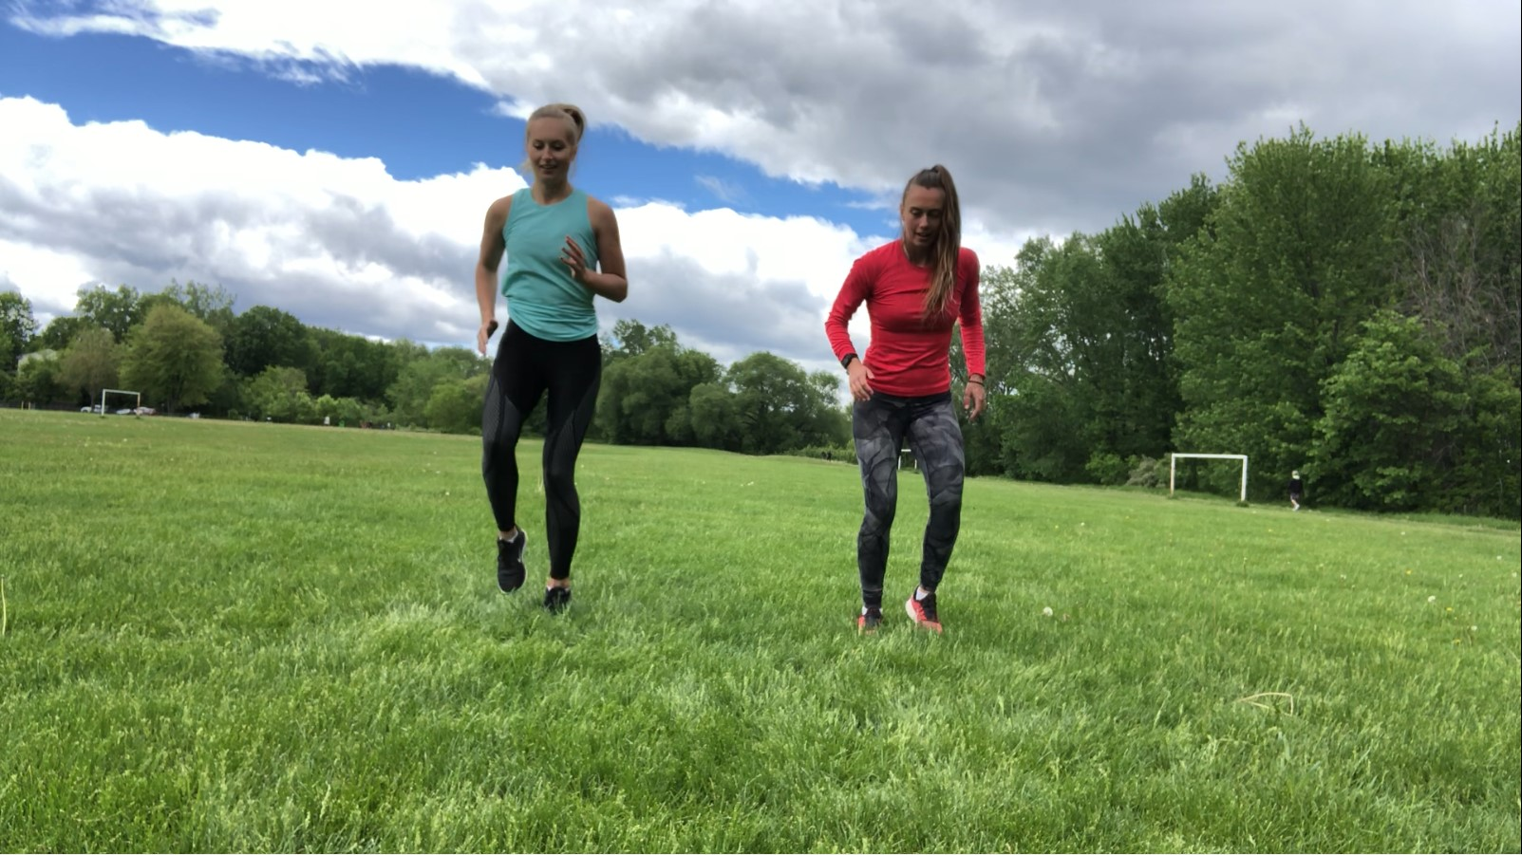
Quick Feet
Inclusive Adaptations:
For more inclusive adaptations see our Inclusion Guide for InterActivities located in the InterActive for Life Building a Virtual Community Resource.
Grade Level Adaptations:
Grades K-4: To decrease difficulty have students perform as a class with the teacher. Students can take turns calling out one command at a time.
Grades 5-12: To decrease difficulty, call out commands slower. To increase difficulty, call out commands quicker, however, do not lose your partner.
For a creative adaptation: Have students play it with "Rock, Paper, Scissors" where different symbols mean different commands.

Slide 7
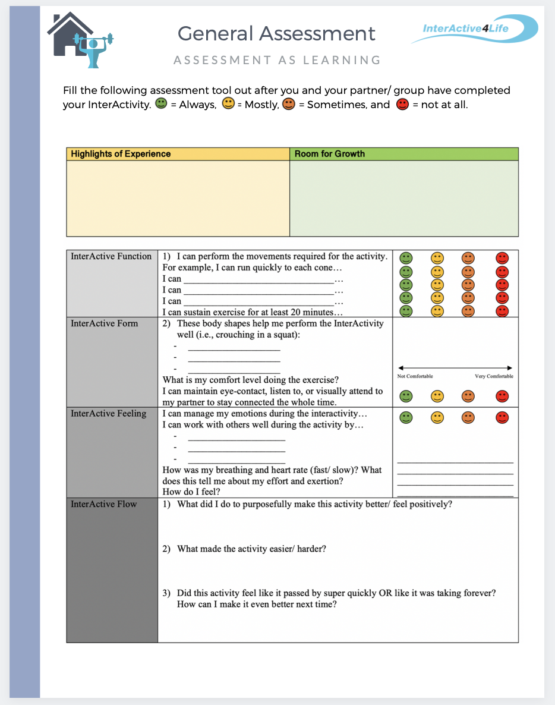
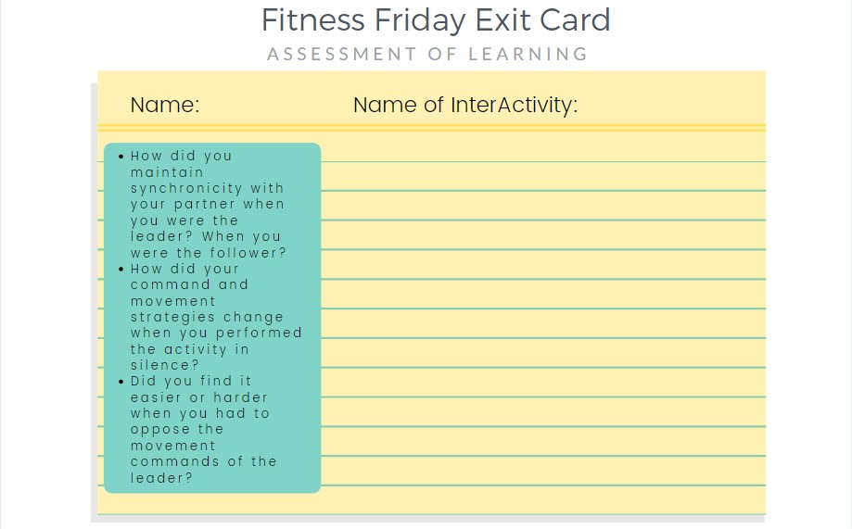
Student Assessment
Notes:
CLICK THE ASSESSMENT ICONs to go to the function2flow website for printable assessment sheets for this online module. Submit these assessment sheets to your teacher’s email.

