Slide 1
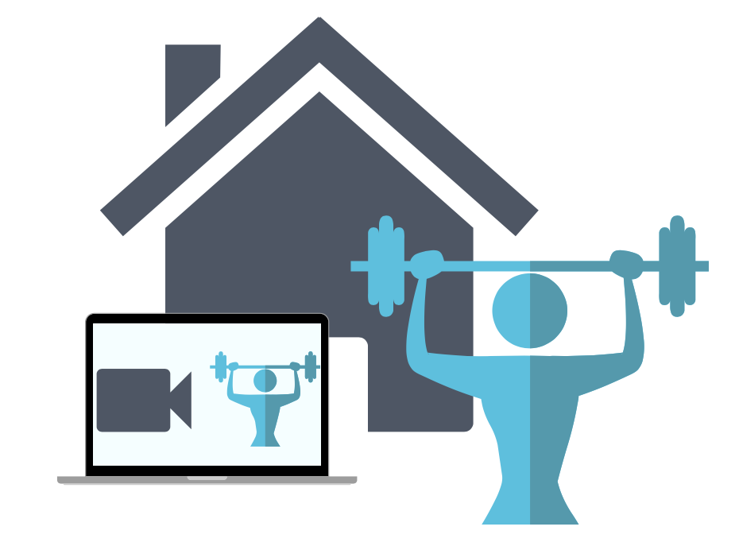
Fitness friday Lesson
From the IA4L’s Building a Virtual Classroom Community At-Home Resource

Slide 2
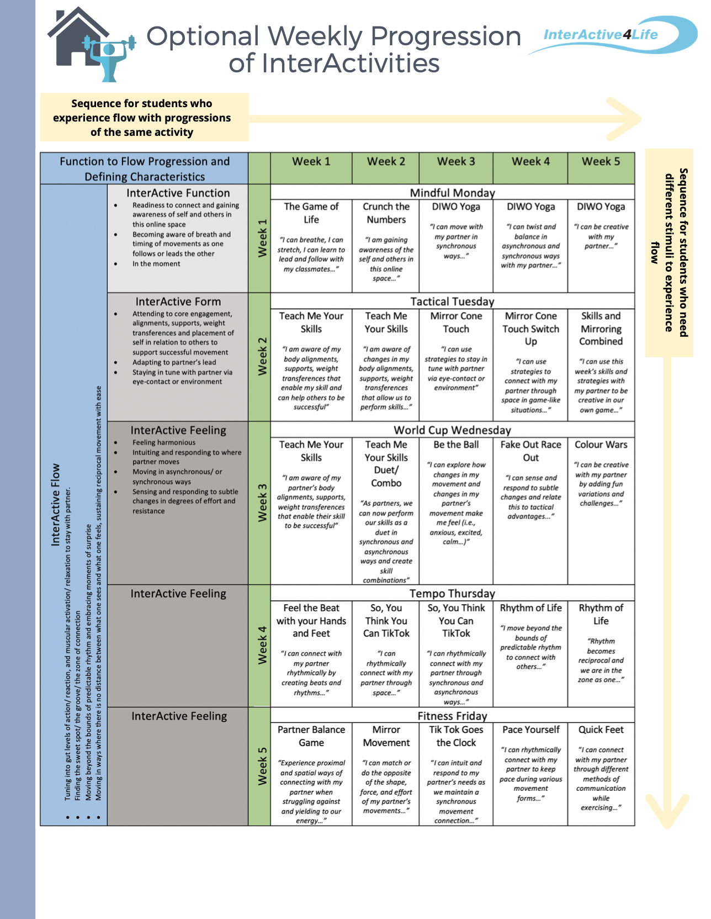
Notes:
There are two ways to progress through this at-home learning module. You can travel down on the table or across. Traveling down (e.g., choosing Week 1 → The Game of Life → Teach Me your Skills → etc... ) would allow more variation in activities each day. One of the major goals of this module is that students experience relational flow with their partners. Some students need more spontaneity and variety to experience this. Traveling across (e.g., Week 3 → Teach Me Your Skills → Teach Me Your Skills Duet → Be The Ball → etc…) allows for progression through the same activity or variations of the same activity which is beneficial for students who like to practise to make things perfect - or in this case, practice to eventually get into a flow state.

Slide 3
Lesson Overview
Welcome to a Fitness Friday Lesson. In today’s lesson we will practise Pace Yourself Interactivity together.
Student Targets
01
Students will tune into their needs and the needs of others while learning to handle stress on their bodies.
Function 2 Flow
02
Develop health and skill related fitness components to increase physical literacy.
Curriculum
Practice stress management and coping skills, social awareness, interpersonal skills, personal skills.
03
Social Emotional Learning

Slide 4
Pace Yourself
Activity Overview: Students will work in groups to determine what it is like to pace themselves for different durations of time.
Warm Up: Students take turns leading their partners through specific cardiovascular movements and dynamic stretches by setting a pace that will ensure the success of the whole group.
Main Activity: Students take turns leading their partners through specific strength exercises by setting a pace that will ensure the success of the whole group.
Cool Down: Students make collaborative decisions to complete specific static stretches and to set a pace that will benefit the wellbeing of the whole group.
We support teachers at home. For more information on this InterActivity see pgs. 69-71 of the IA4L Building a Virtual Community At-Home Resource.
Clipartkey
Notes:
Image Retrieved from: https://www.clipartkey.com/view/bhxoho_clip-art/
Image Retrieved from: https://www.clipartkey.com/downpng/TbRwT_transparent-alarm-clock-clip-art-clock-clipart/

Slide 5
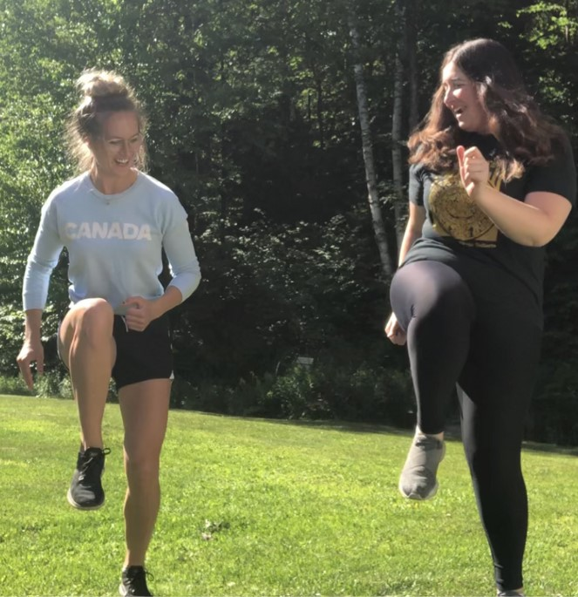
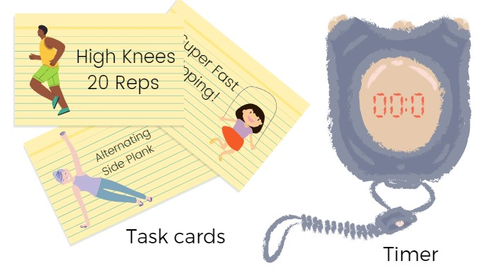
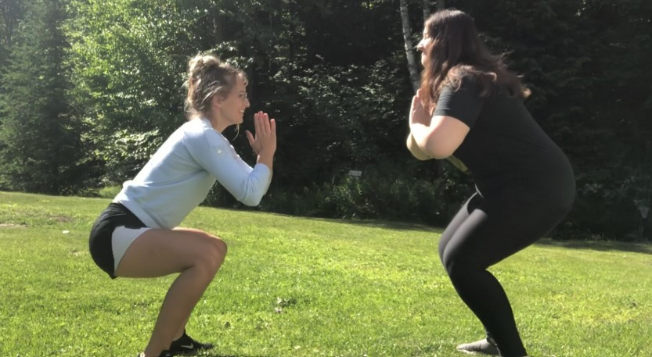
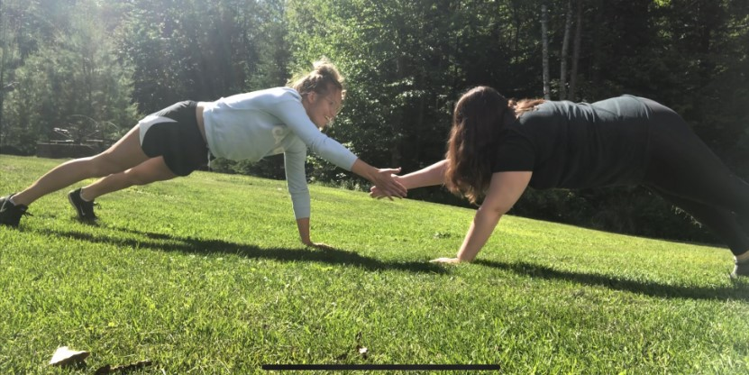
Pace Yourself
Main Activity: Pacing strength exercises
Canva

Slide 6
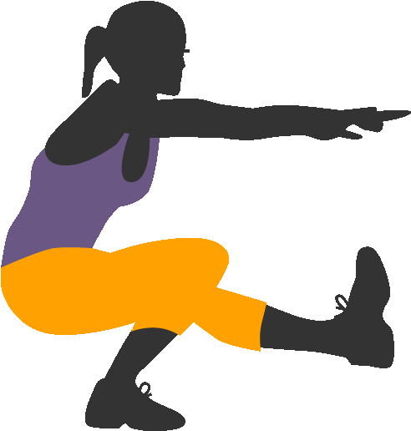
Pace Yourself
Inclusive Adaptations:
Assign exercises to target a certain part of the body (i.e., chest, back, hamstrings, core, etc).
Assign exercises that can only be performed on a certain level (i.e., on a chair or on the ground).
Introduce a manipulative that must be used to perform the exercises (i.e., ball or rope).
For more inclusive adaptations see our Inclusion Guide for InterActivities located in the InterActive for Life Building a Virtual Community Resource.
Grade Level Adaptations:
Grades K-9: To decrease difficulty, decrease the amount of exercises. To increase difficulty, have students perform exercises with a manipulative (i.e., dribble ball).
Grades 10-12: To decrease difficulty, decrease the duration of time the students have to perform the movements for. To increase difficulty, have students perform some exercises with small weights. To promote teamwork, have students count out loud together.
Clipartkey
Notes:
Image retrieved from: https://www.clipartkey.com/downpng/bboRTh_clip-art/
Image retrieved from: https://www.clipartkey.com/downpng/bTixhm_triple-jump/
Image retrieved from: https://www.clipartkey.com/downpng/iimTwh_clip-art-crunched-clipart-ubisafe-the-transparent-background/

Slide 7
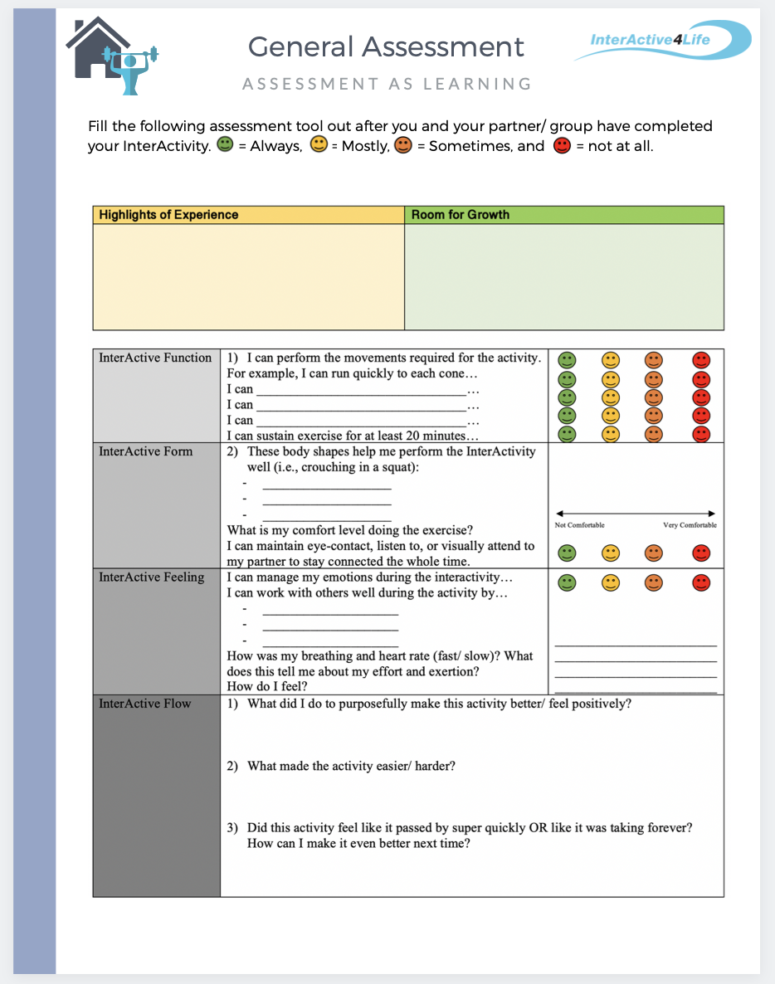
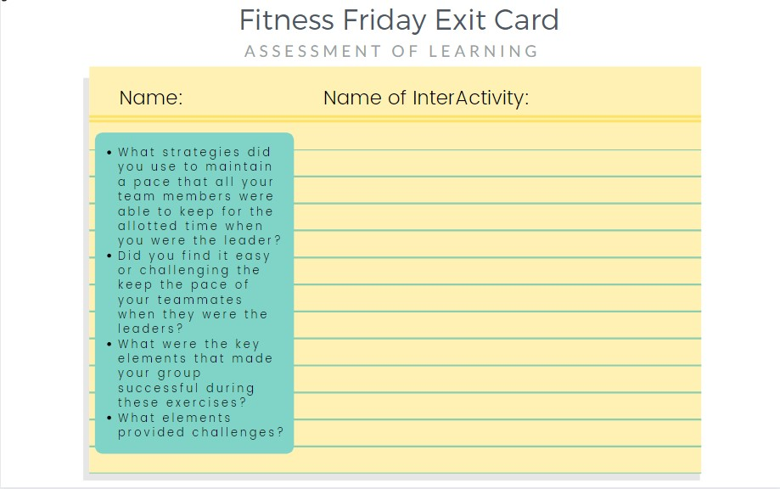
Student Assessment
Notes:
CLICK THE ASSESSMENT ICONs to go to the function2flow website for printable assessment sheets for this online module. Submit these assessment sheets to your teacher’s email.

