Slide 1
Mindful Monday Lesson
From the IA4L’s Building a Virtual Classroom Community At-Home Resource

Slide 2
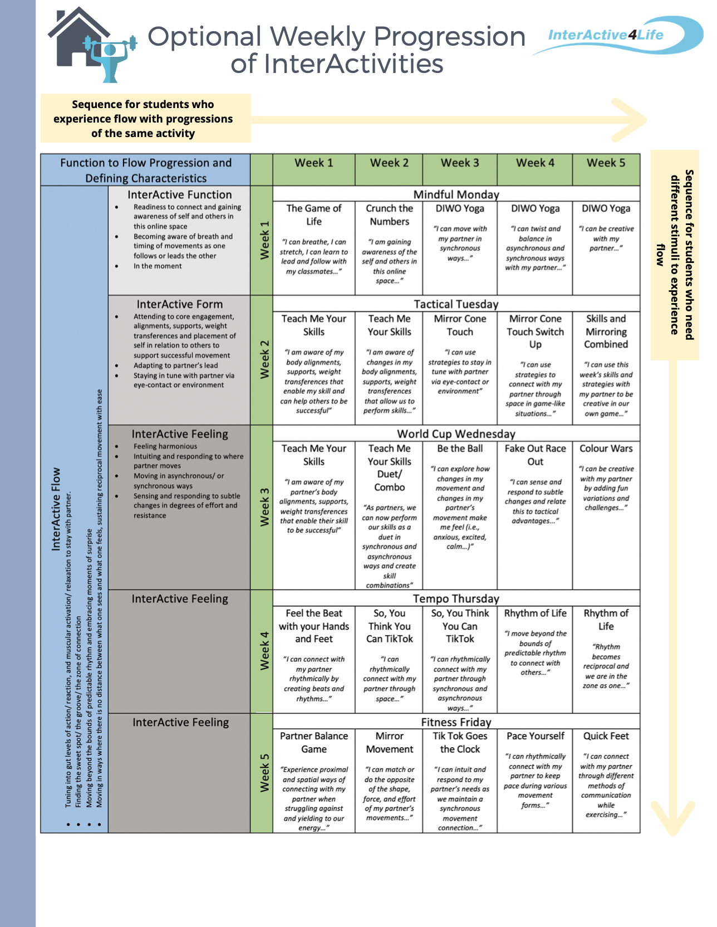
Notes:
There are two ways to progress through this at-home learning module. You can travel down on the table or across. Traveling down (e.g., choosing Week 1 → The Game of Life → Teach Me your Skills → etc... ) would allow more variation in activities each day. One of the major goals of this module is that students experience relational flow with their partners. Some students need more spontaneity and variety to experience this. Traveling across (e.g., Week 3 → Teach Me Your Skills → Teach Me Your Skills Duet → Be The Ball → etc…) allows for progression through the same activity or variations of the same activity which is beneficial for students who like to practise to make things perfect - or in this case, practice to eventually get into a flow state.

Slide 3
Lesson Overview
Welcome to a Mindful Monday Lesson. In today’s lesson we will practise DIWO Yoga (Do It With Others) Interactivity together.
Student Targets
01
Explore synchronous forms of connection through space.
Function 2 Flow
02
Learn to perform a variety of movement skills relating to balance and coordination.
Curriculum
03
Practice social awareness and relationship skills, self-awareness and self-monitoring skills, and critical and creative thinking.
Social Emotional Learning

Slide 4
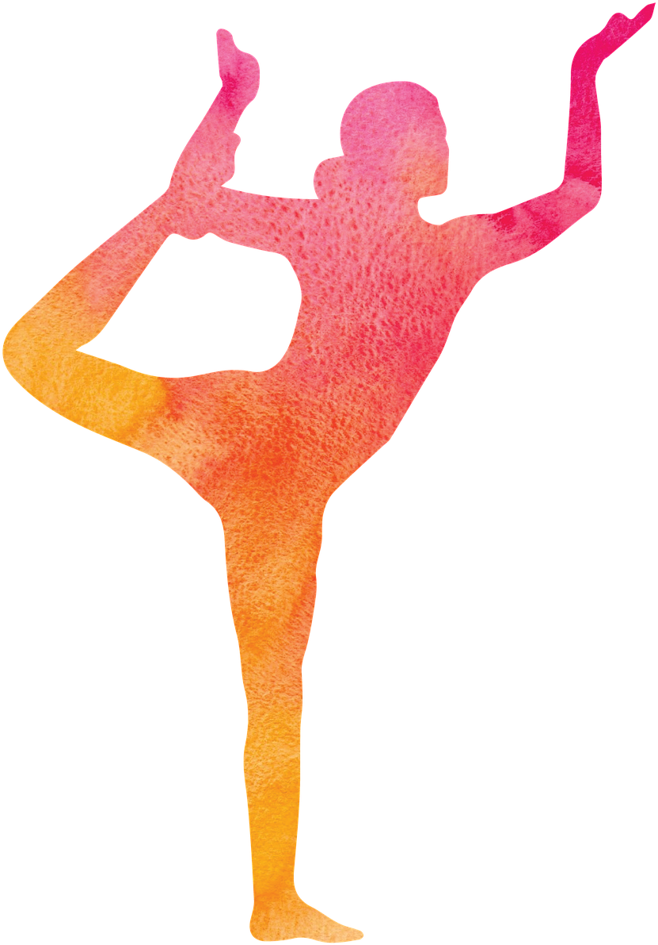
DIWO Yoga
Activity Overview: Using inquiry-based methods, this yoga activity is up to the students to decide! Students will practice principles of good leadership as they cooperatively lead each other through a yoga routine.
Warm Up: The instructor facilitates an open group discussion about a self care topic. For example, what self care means and why it is important, various methods of self care in different areas of one’s life, and how to develop a self care plan.
Main Activity: Part 1) students research or create their own yoga move to teach their classmates. Use the DIWO Yoga Sequence Handout. Part 2) The class makes a yoga sequence out of everyone’s movements and performs them together.
Cool Down: The instructor takes students through a guided meditation to promote relaxation and inner peace.
We support teachers at home. For more information on this InterActivity and ONLINE ADAPTATIONS see the p.18 & 19 of the IA4L Building a Virtual Community At-Home Resource.
Clipartkey
Notes:
Image Retrieved from: https://www.clipartkey.com/search/yoga/

Slide 5
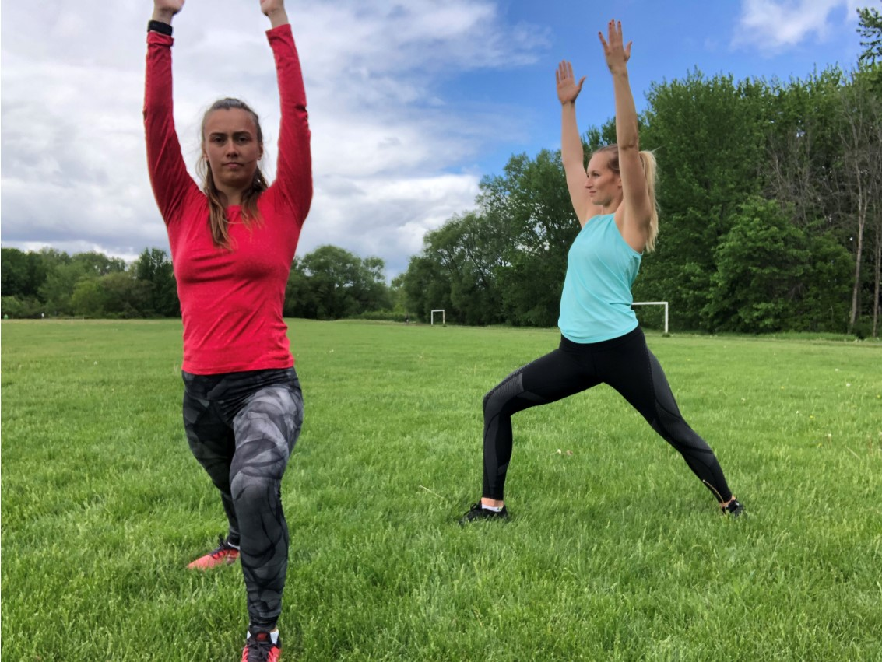
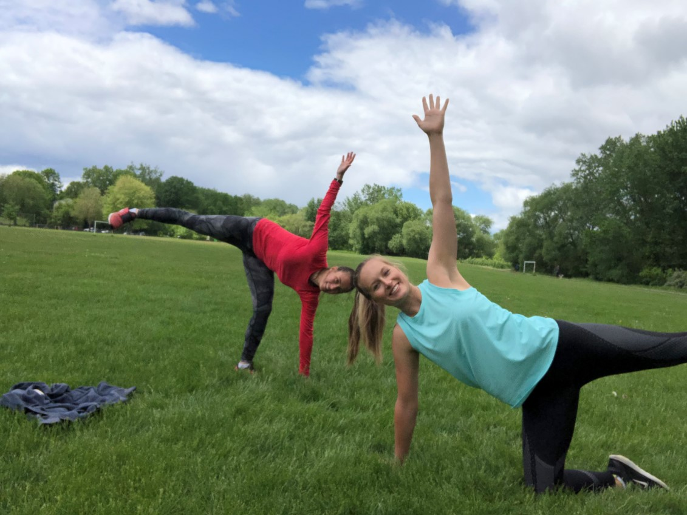
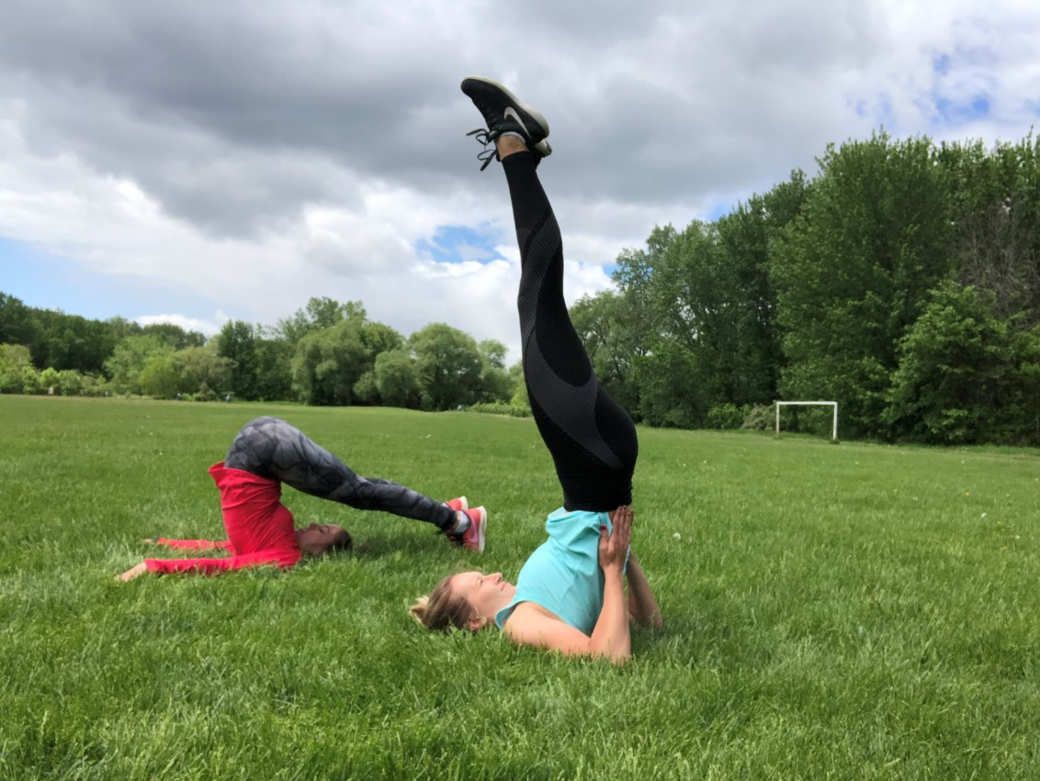
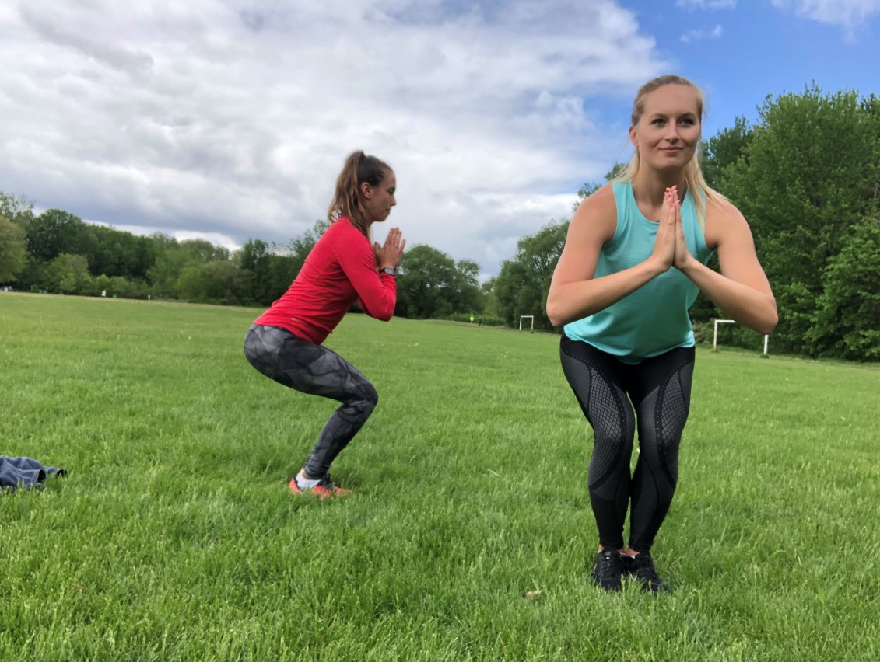
DIWO YOGA
Main Activity: DIWO Yoga
Warm Up: Group Discussion Self-Talk
Clipartkey
Need inspiration? Check out our DIWO Yoga Pose Handout in our Tools for Teachers Section.
Notes:
Image retrieved from: https://www.clipartkey.com/downpng/hhRTmi_tell-us-about-your-community-discussion/

Slide 6
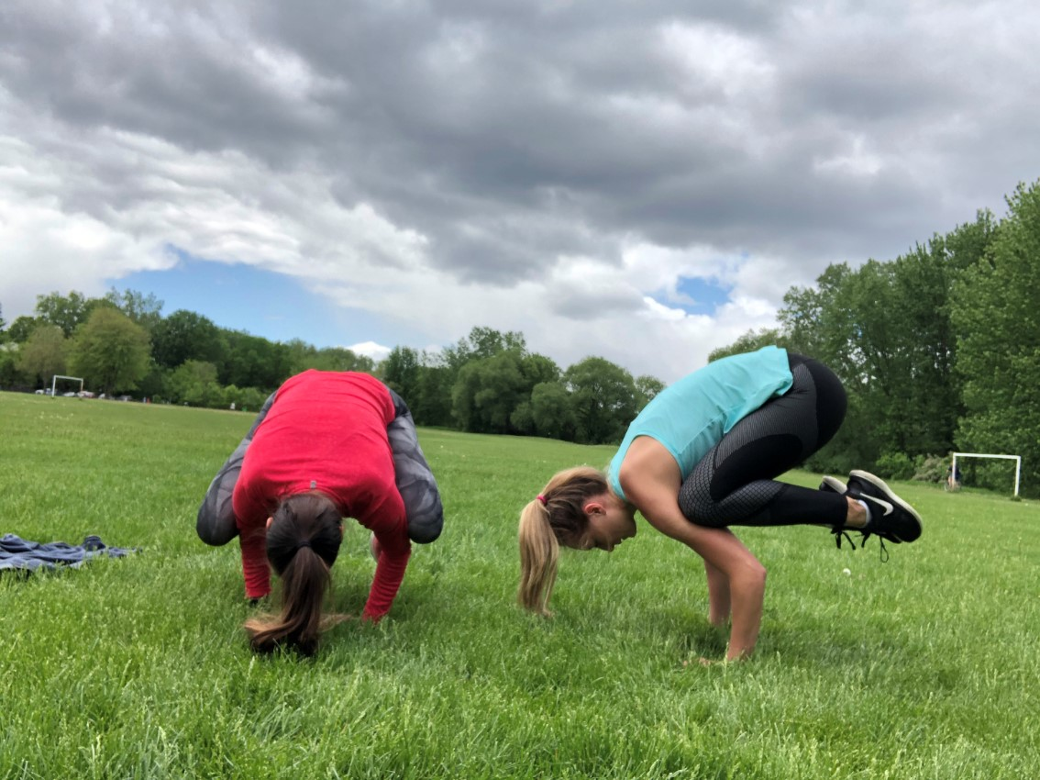
DIWO YOGA
Inclusive Adaptations:
Change the locomotor (i.e. restrict to solely seated yoga movements or movements involving the upper/lower body).
Have students create alternative variations progressing in difficulty level for each movement.
For more inclusive adaptations see our Inclusion Guide for InterActivities located in the InterActive for Life Building a VIrtual Community Resource.
Grade Level Adaptations:
Grades K-5: To decrease difficulty, have students work in groups to research their yoga move. To increase difficulty restrict movements to a certain plane or section of the body.
Grades 6-12-: To decrease difficulty, assign each student a basic yoga movement to research. To increase difficulty, have students research and teach their classmates a sequence of yoga movements.

Slide 7
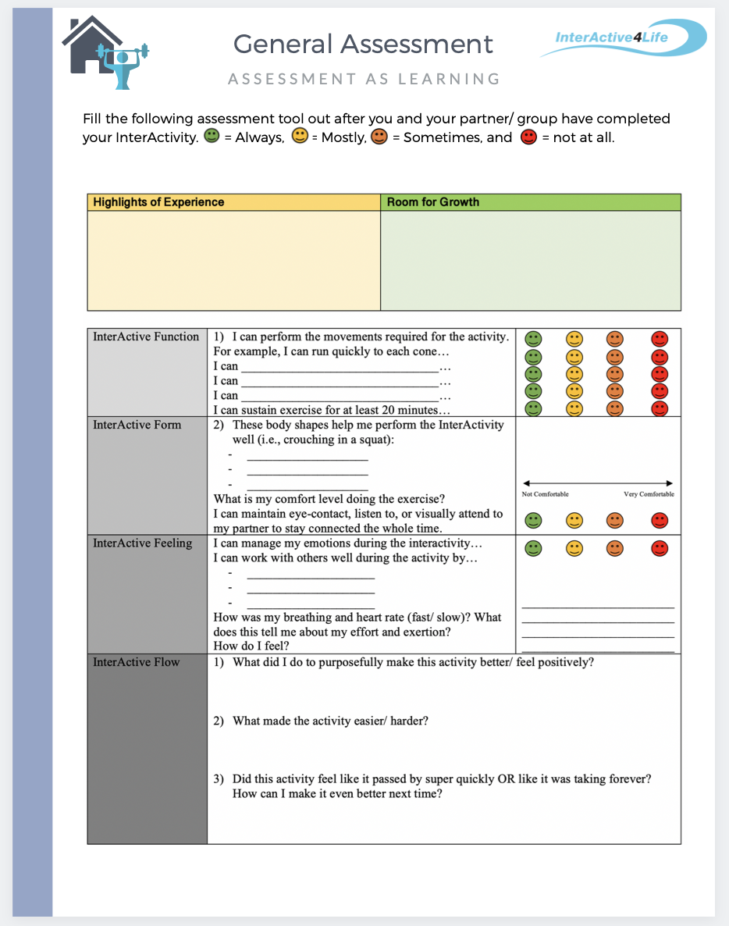
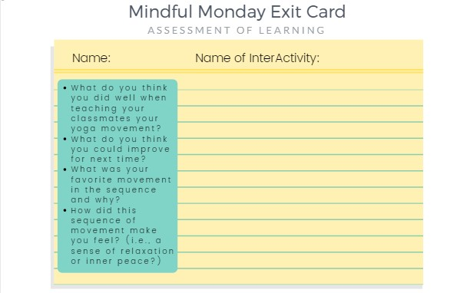
Student Assessment
Notes:
CLICK THE ASSESSMENT ICONs to go to the function2flow website for printable assessment sheets for this online module. Submit these assessment sheets to your teacher’s email.

