Slide 1
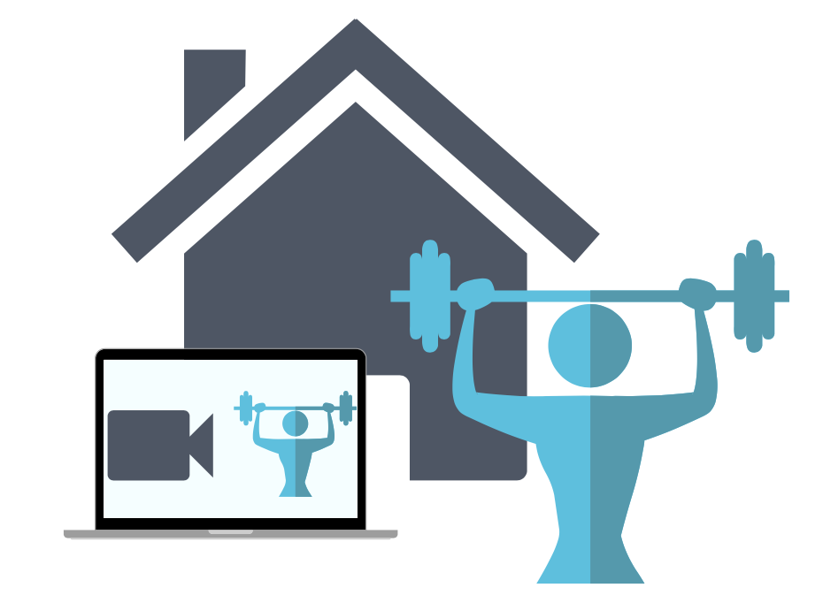
Fitness friday Lesson
From the IA4L’s Building a Virtual Classroom Community At-Home Resource

Slide 2
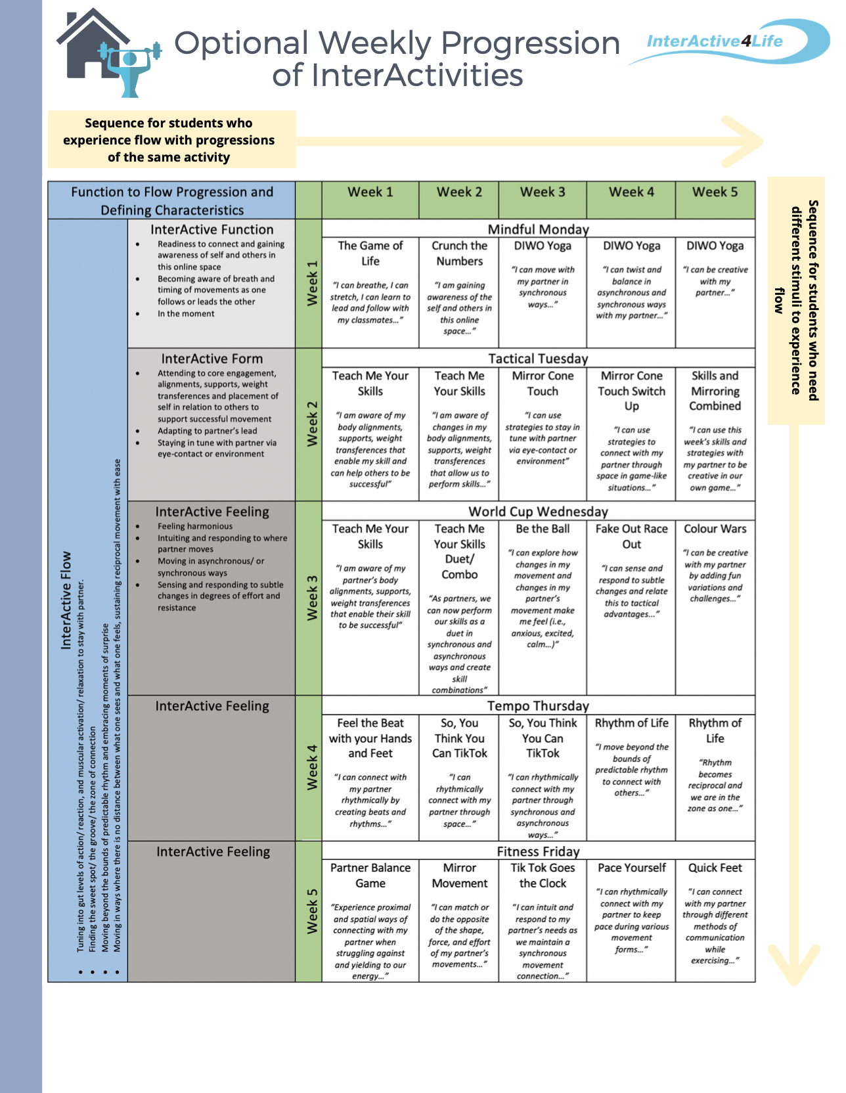
InterActive Feeling
Lean On Me
“I can intuit and respond to my partners needs”
Notes:
There are two ways to progress through this at-home learning module. You can travel down on the table or across. Traveling down (e.g., choosing Week 1 → The Game of Life → Teach Me your Skills → etc... ) would allow more variation in activities each day. One of the major goals of this module is that students experience relational flow with their partners. Some students need more spontaneity and variety to experience this. Traveling across (e.g., Week 3 → Teach Me Your Skills → Teach Me Your Skills Duet → Be The Ball → etc…) allows for progression through the same activity or variations of the same activity which is beneficial for students who like to practise to make things perfect - or in this case, practice to eventually get into a flow state.

Slide 3
Lesson Overview
Welcome to a Fitness Friday Lesson. In today’s lesson we will practise Lean On Me InterActivity together.
Student Targets
01
Build capacity to connect in a synchronous way through proximal and distal energy play.
Function 2 Flow
02
Develop health and skill related fitness components to increase physical literacy.
Curriculum
03
Stress management in time-pressured situations.
Social Emotional Learning

Slide 4
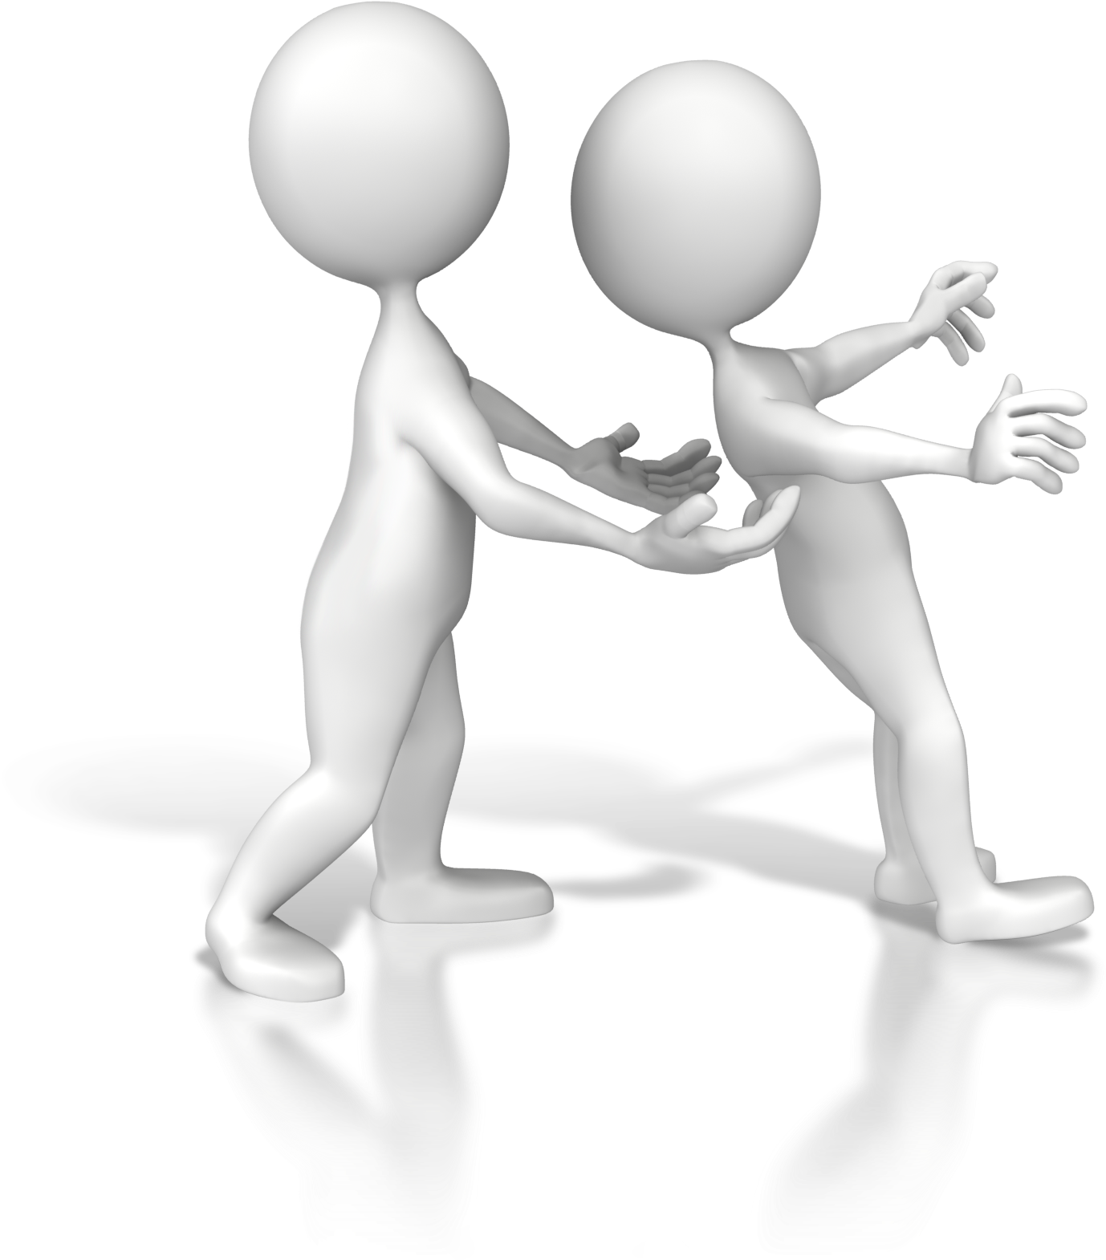
Lean On Me
Activity Overview: Participants will experience balancing and steadying their body, and the body of their partner.
Warm Up: Students take turns leading each other through various dynamic stretches without verbal communication while trying to maintain a synchronous connection.
Main Activity: Participants learn how to be ready to connect with a partner by taking turns leaning into each other while exploring various depths and positions.
Cool Down: In pairs, students take turns leading each other through various static stretches while helping each other reach deeper into each stretch.
We support teachers at home. For more information on this InterActivity and ONLINE ADAPTATIONS see pgs. 66-68 of the IA4L Building a Virtual Community At-Home Resource.
Clipartkey
Notes:
Image Retrieved from:https://www.clipartkey.com/downpng/wiRRwo_trust-me-1600-clr-7204-trust-fall-stick/

Slide 5
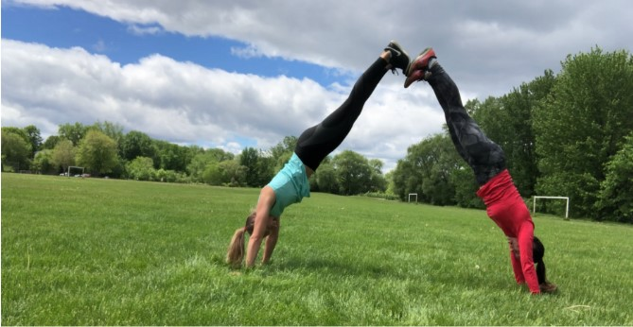
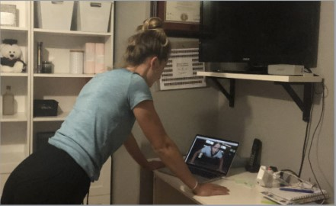
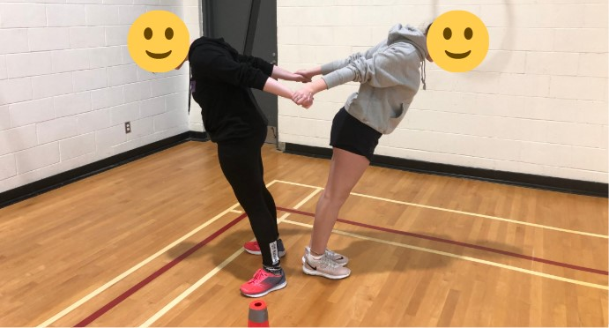
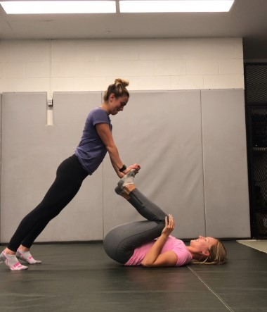
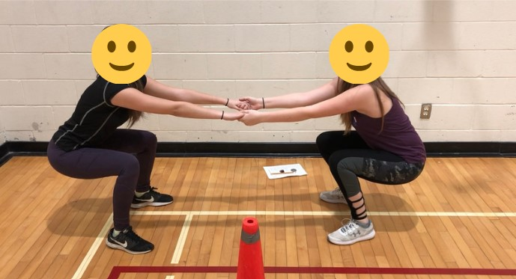
Lean on Me
Main Activity: Lean On Me In Person Edition
Main Activity: Lean On Me Virtual Edition

Slide 6
Lean On Me
Inclusive Adaptations:
Use of manipulative to eliminate the need for touch (i.e., stability ball).
For more inclusive adaptations see our Inclusion Guide for InterActivities located in the InterActive for Life Building a Virtual Community Resource.
Grade Level Adaptations:
Grades K-8: Real-life partners: Progress lean to shoulders on feet or hips on feet performing a partner leg press. Virtual partners: Progress lean by attempting on one leg.
Grades 9-12: Real-life partners: Progress lean to greater depths, invert your lean, forward facing lean, and posterior leans while squatting. Virtual Partners: Progress depth of wall or invert your trust lean.
istockphoto
Notes:
Image retrieved from: https://www.istockphoto.com/ca/illustrations/lean-on-shoulder?mediatype=illustration&phrase=lean%20on%20shoulder&sort=mostpopular

Slide 7
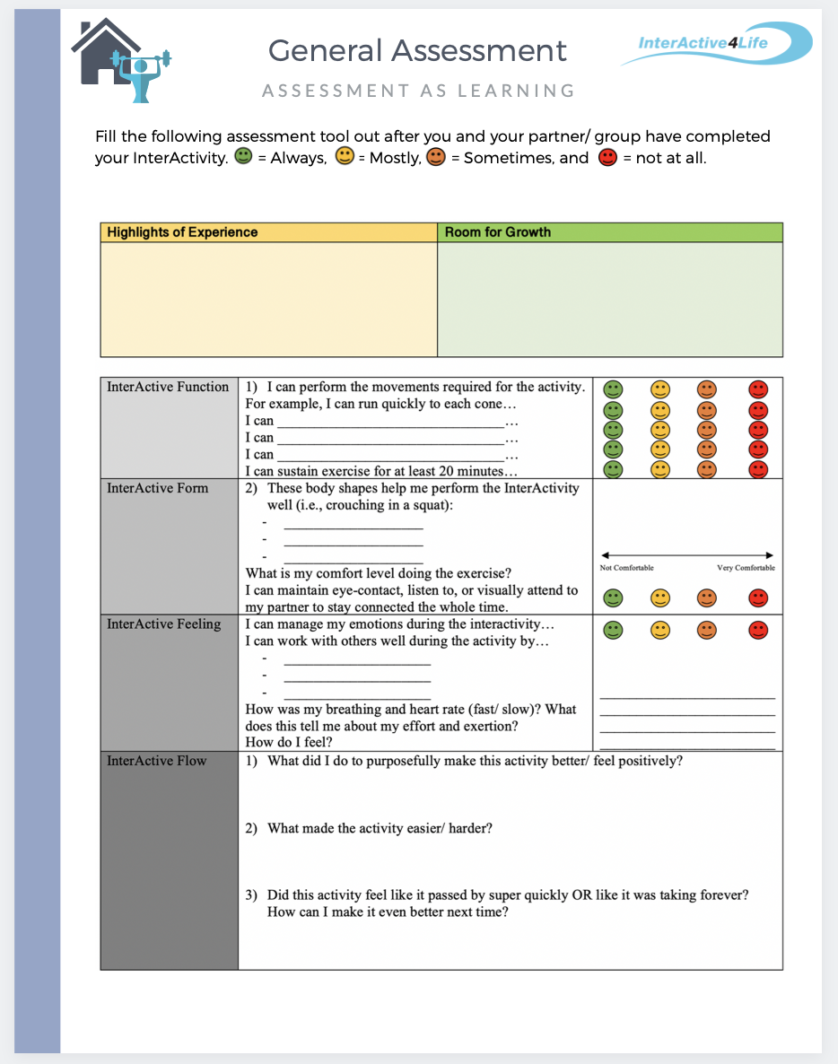
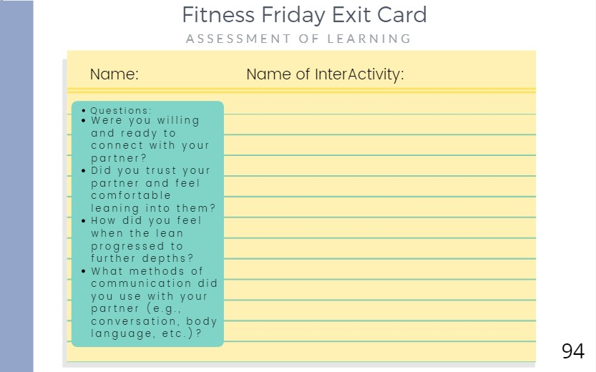
Student Assessment
Notes:
CLICK THE ASSESSMENT ICONs to go to the function2flow website for printable assessment sheets for this online module. Submit these assessment sheets to your teacher’s email.

