Slide 1
Mindful Monday Lesson
From the IA4L’s Building a Virtual Classroom Community At-Home Resource

Slide 2
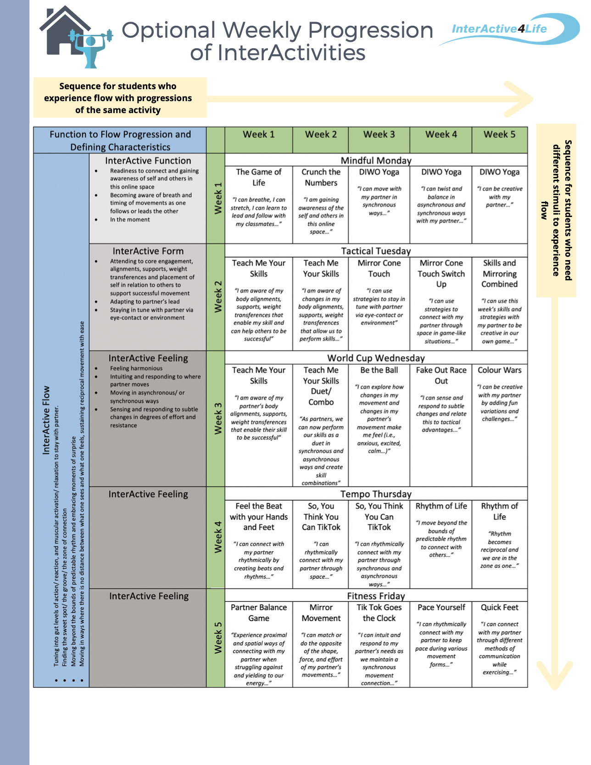
Notes:
There are two ways to progress through this at-home learning module. You can travel down on the table or across. Traveling down (e.g., choosing Week 1 → The Game of Life → Teach Me your Skills → etc... ) would allow more variation in activities each day. One of the major goals of this module is that students experience relational flow with their partners. Some students need more spontaneity and variety to experience this. Traveling across (e.g., Week 3 → Teach Me Your Skills → Teach Me Your Skills Duet → Be The Ball → etc…) allows for progression through the same activity or variations of the same activity which is beneficial for students who like to practise to make things perfect - or in this case, practice to eventually get into a flow state.

Slide 3
Lesson Overview
Welcome to a Mindful Monday Lesson. In today’s lesson we will practise The Game of Life - Rock, Paper, Scissors, Glue Interactivity together.
Student Targets
01
Gain awareness of the self and others in this online space and be in the moment.
Function 2 Flow
02
Learn to perform a variety of movement skills relating to balance and coordination.
Curriculum
03
Become more self-aware, identify sources of stress, and learn effective coping strategies.
Social Emotional Learning

Slide 4
The Game of Life
Activity Overview: Students are introduced to the idea of tuning into themselves in space and with others. Through yogic activities students explore the zone of flow which they can develop into a relational experience as the week progresses.
Warm Up: The instructor facilitates an open group discussion about a self care topic. For example, what self care means and why it is important as well as various methods of self care in different areas of one’s life.
Main Activity: Students build bodily awareness and self-regulation in a game of Rock, Paper, Scissors, Glue. Participants aim to land on the same symbol. Each symbol represents a different stressor that the participants must cooperatively navigate through. If participants land on different symbols, they must do a push-up (or other movement) together before continuing.
Cool Down: The instructor takes students through a guided meditation to promote relaxation and inner peace and has them complete the Finding Support in the Body Activity Sheet.
WATCH THIS ON (CLICK HERE)
We support teachers at home. For more information on this InterActivity see the p.11, 13, & 14 of the IA4L Building a Virtual Community At-Home Resource.
Clipartkey
Notes:
Image Retrieved from: https://www.clipartkey.com/view/ibJoob_download-yoga-png-transparent-international-yoga-day-2019/

Slide 5
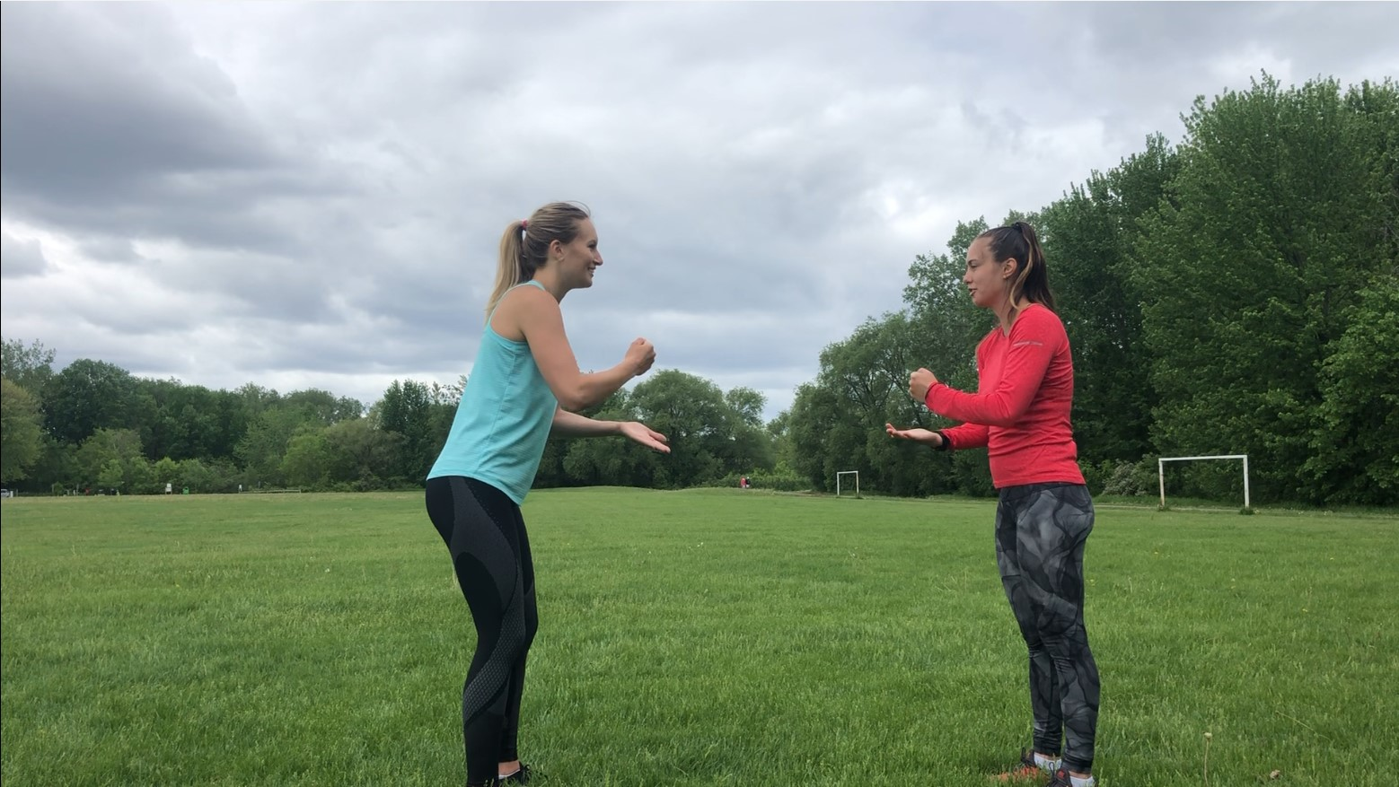
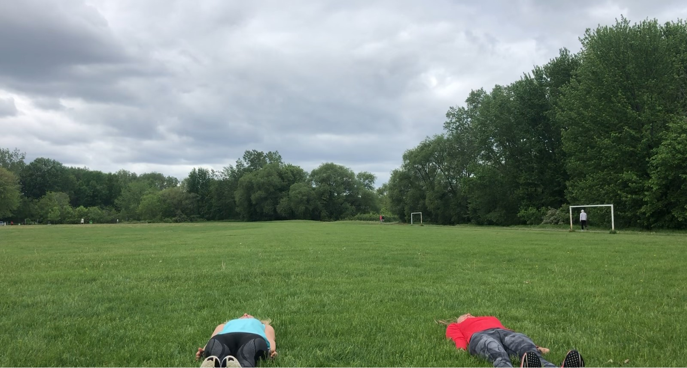
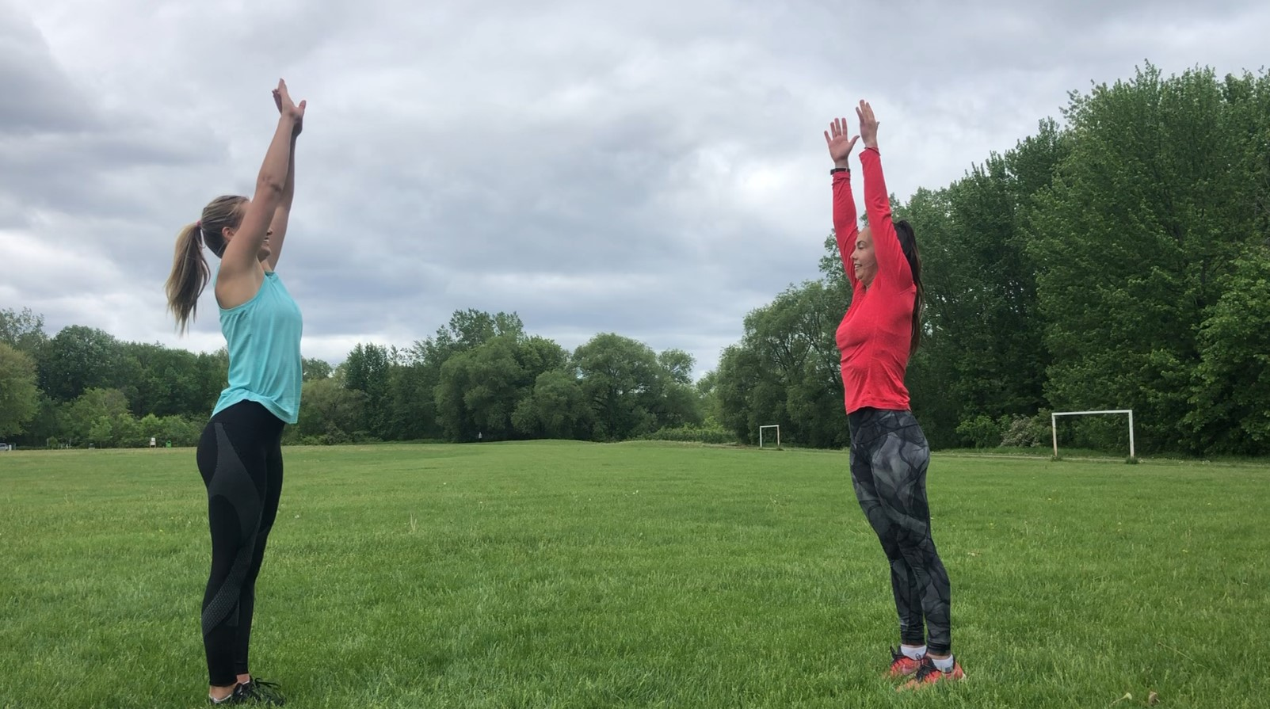
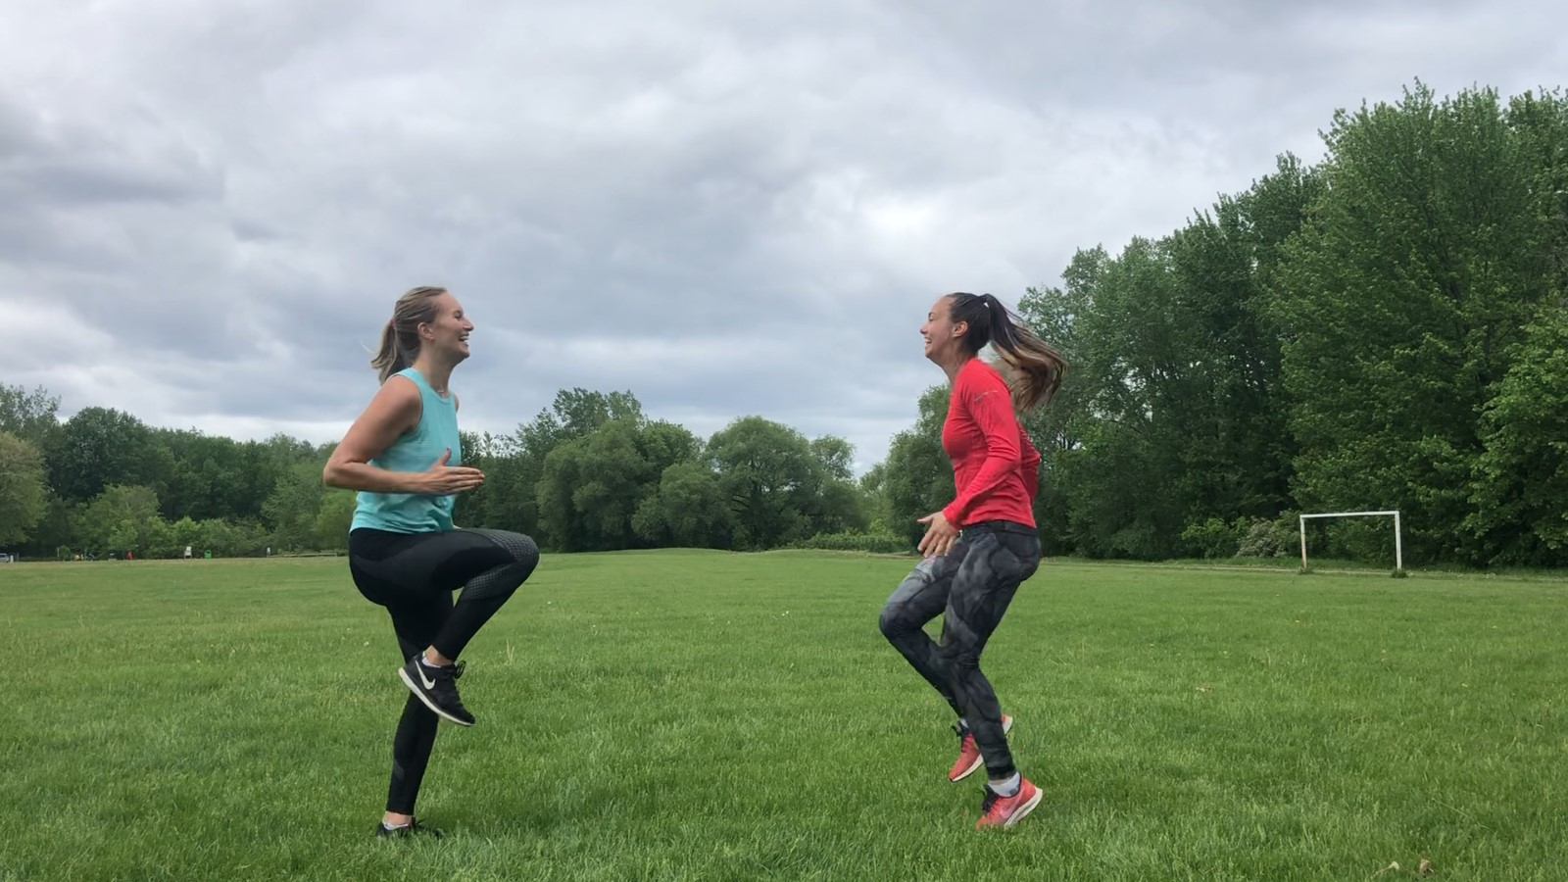
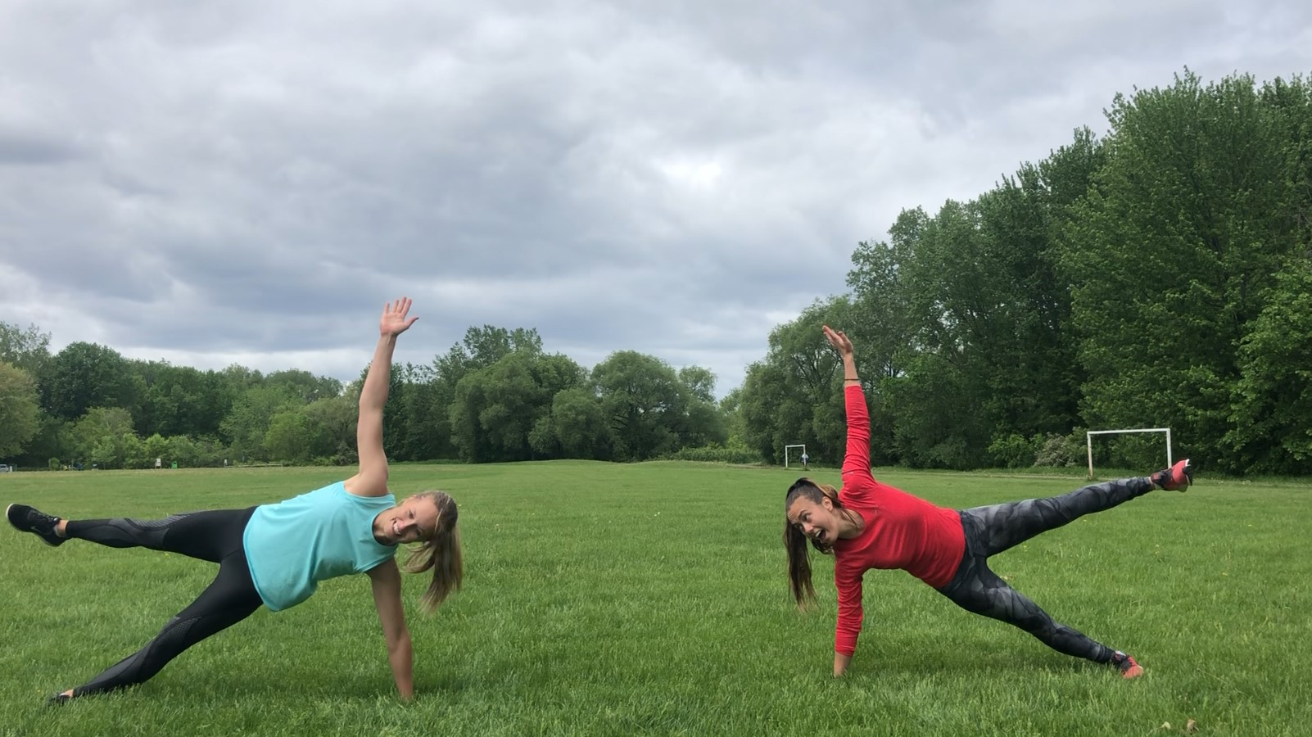
The Game of Life
Main Activity: The Game of Life
Rock Paper Scissors, Glue Edition
Warm Up: Group Discussion Self-Talk
Rock: tense and relax
Paper: flow yoga sequence
Clipartkey
Scissors: aerobic exercise
Glue: balance on a base of Support
Notes:
Image retrieved from: https://www.clipartkey.com/downpng/hhRTmi_tell-us-about-your-community-discussion/

Slide 6
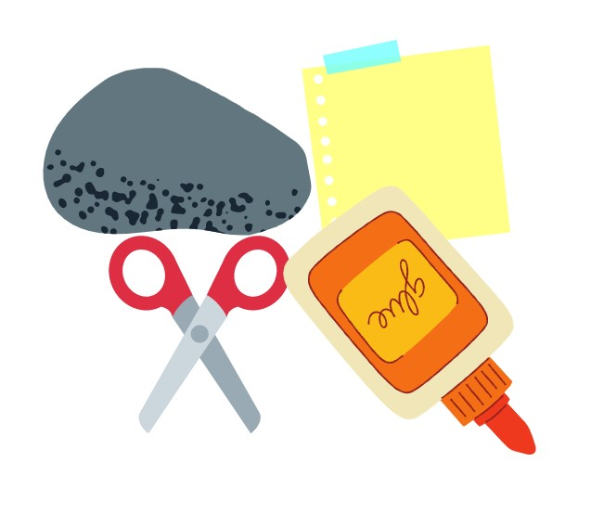
The Game of Life
Inclusive Adaptations:
Change the locomotor by restricting the activities to solely seated yoga movements or movements involving the upper/lower body.
Provide easier and harder variations for each movement.
For more inclusive adaptations see our Inclusion Guide for InterActivities located in the InterActive for Life Building a Virtual Community Resource.
Grade Level Adaptations:
Grades K-5: Adapt Find Your Flow to creating movement stories. Have students pretend they are travelling through a zoo. As the instructor calls out the animal name, student bend and balance in a static position that looks like the animal.
Grades 6-12: Travel through the Game of Life as a whole yoga routine. Students will then have the opportunity to develop concentration skills on longer tasks. For creative adaptations, ask students to come up with poses themselves.
Canva

Slide 7
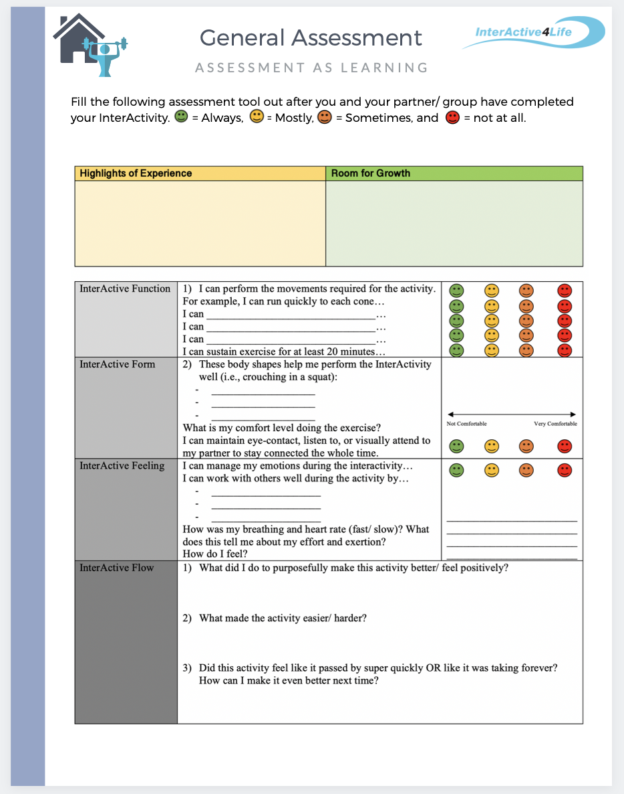
Student Assessment
Notes:
CLICK THE ASSESSMENT ICONs to go to the function2flow website for printable assessment sheets for this online module. Submit these assessment sheets to your teacher’s email.

